Slide 1
Čitati ili ne čitati? AI će odlučiti.
Dajana Jelavić, prof. mentor
Mirta Kos Kolobarić, prof. savjetnik

Slide 2
Pitanje za vas:
"It might surprise you to learn that sugar consumption (in the UK and other developed countries at least) has actually been steadily decreasing over the past decade.
This could be happening for any number of reasons, such as a shift in tastes and lifestyles, with the popularity of low-carbohydrate diets, like keto, increasing in the past decade. A greater understanding of the dangers of eating excess sugar on our health may also be driving this drop."

Slide 5
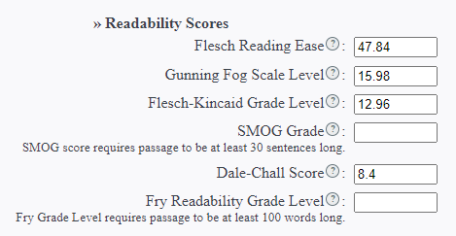
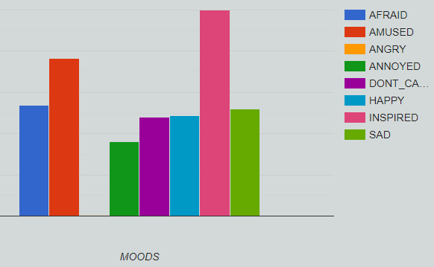
Što kaže AI?

Slide 6
Ishodi
Sudionik interaktivnog izlaganja koristi AI za analizu teksta u svrhu podizanja čitalačke sposobnosti/pismenosti svojih učenika u vlastitom kontekstu podučavanja.
Sudionik interaktivnog izlaganja koristi AI za analizu emocija u tekstu u kontekstu svog podučavanja.

Slide 7
Ciljevi
staviti učenika u centar podučavanja
povećati razinu interakcije učenika s radnim materijalom
omogućiti optimalno usvajanje ishoda učenja
produžiti retenciju znanja
smanjiti kognitivno opterećenje učenika nakon nastave na daljinu
razviti sposobnost samostalnog učenja kod učenika
razviti socio-emocionalne vještine

Slide 8
Edward Everett
Abraham Lincoln

Slide 9
Readability Analyzer
"Readability analyzer“ je jedna od mnogobrojnih online aplikacija koja određenim parametrima mjeri čitljivost nekog teksta.
Nakon što unesemo tekst ili samo URL neke stranice dobijemo statistiku koja nam pokazuje broj rečenica, riječi, slogova, broj trosložnih riječi i broj pasivnih konstrukcija na temelju čega se određuje za koju dob/razinu/razred je pogodan.
Gunning Fog Indeks/Flesch Reading Ease

Slide 10
Primjena
1. Individualiziran pristup učeniku (jigsaw metoda;učenici s teškoćama u učenju)
2. Priprema za ispit državne mature iz engleskog jezika (open i closed cloze testovi; sinonimi)
3. Utvrđivanje primjerenosti raznih autentičnih sadržaja ili onih koje stvara sam nastavnik

Slide 11
Čitljivost za komunikaciju budućnosti
kratak raspon pažnje i koncentracije, nestrpljenje
izbjegavanje čitanja i gubitak motivacije za većinu sadržaja
omogućava rad na tekstovima koji su po mjeri učenika, usklađeni s njihovom dobi, sposobnostima i jezičnom razinom
poruke i informacije će se još brže izmjenjivati
u kraćem roku će morati procesuirati više sadržaja
razgovore će češće voditi s NLG tehnologijom

Slide 12
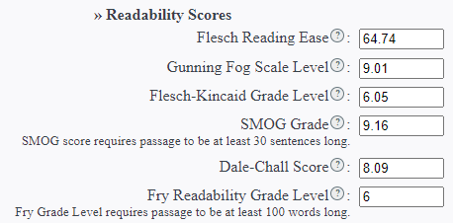
Primjeri iz nastave What happens to your brain when you give up sugar?

Slide 13
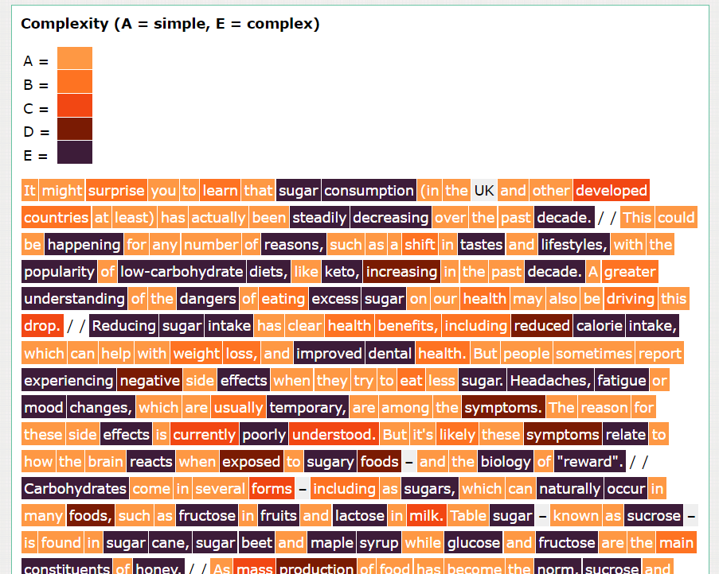
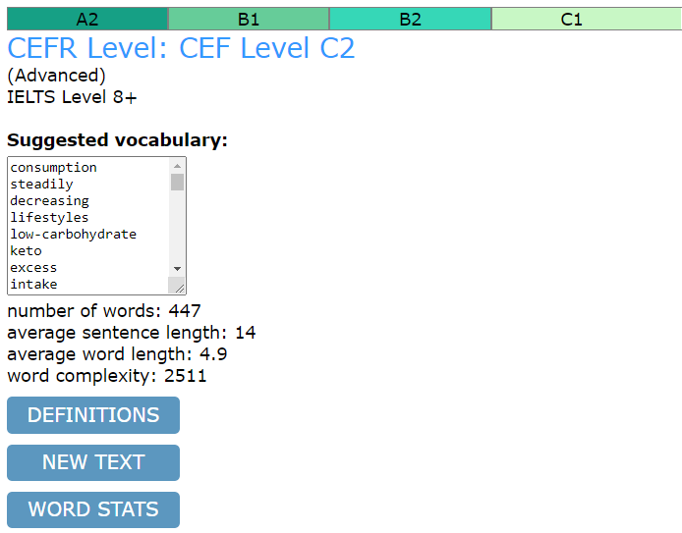
RoadtogrammarTextanalyzer

Slide 14
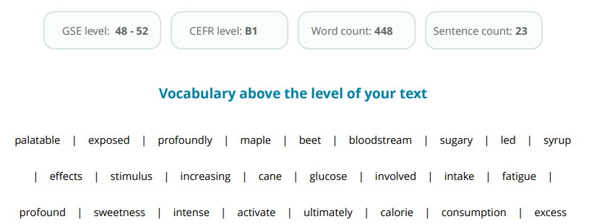
PearsonTextanalyzer

Slide 15
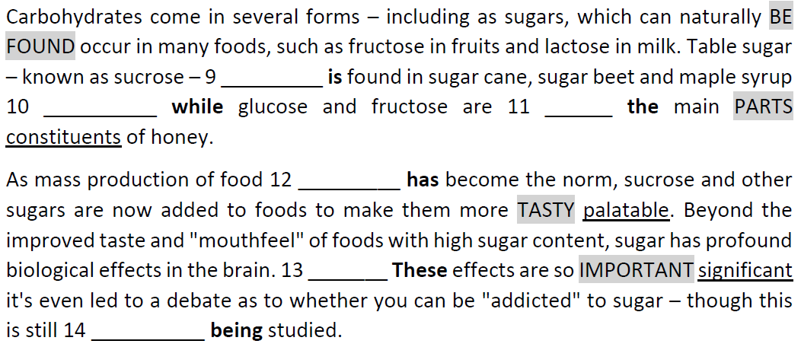
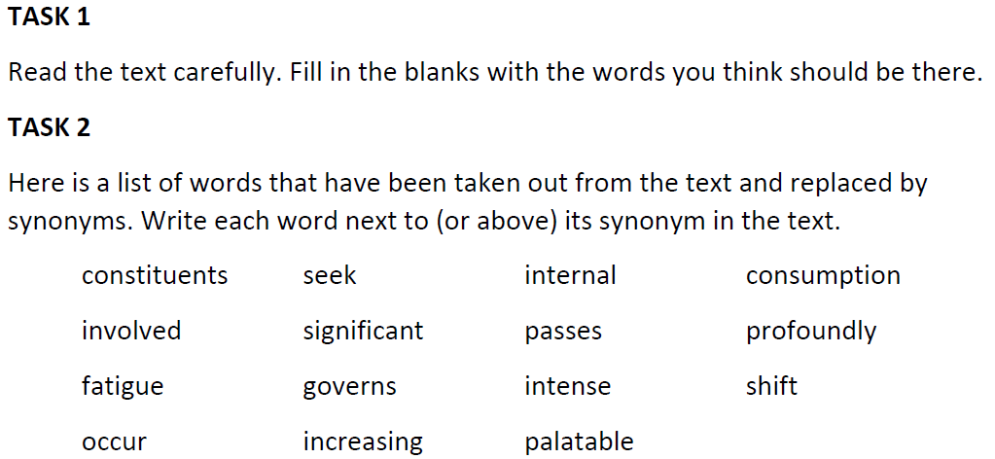
Aktivnost na temelju izdvojenih riječi

Slide 16
DepecheMood
"Depeche Mood“ je online aplikacija koja analizom riječi identificira emocije u nekom tekstu odnosno prevladavajuće raspoloženje ili ton. Statistika je vizualno prikazana vrlo atraktivno u obliku grafikona u boji.
Pixabay

Slide 17
Primjena
1.mjerenje emocija/raspoloženja/ prevladavajućeg tona u nekom tekstu
2.bolje razumijevanje teksta, ideja, stavova i svrhe pisanja
3.vještina kritičkog mišljenja - manipuliranje emocijama (medijska pismenost)
4.motiviranje učenika „sretnijim/pozitivnijim“ tekstovima
5.rješavanje problema ranog napuštanja školovanja

Slide 18
Primjeri iz nastave

Slide 19
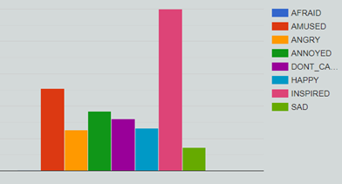
Survey on online teaching
What was good about online teaching?
What would help to make it better?
How much did you learn?
"I liked everything about online teaching. It was a bit difficult to catch-up what task are we doing, but you would tell us every time we asked you. To make it better/help would be a slower explaining because my Internet sometimes stopped working. I learned a lot when I was connected in call." (Ana,3.a)

Slide 20
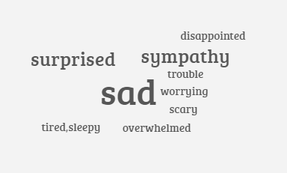
Uvodna aktivnost u temu: Svijet rada
"In July, Mark, who works for a small technology company in East London, emailed his manager to tell her that he had tested positive for Covid-19. His boss didn’t ask any questions; instead, she expressed sympathy, wished him a quick recovery and told him to take as much time off as he wanted.
Mark, whose surname is being hidden for job-security reasons, didn’t actually have Covid-19. In truth, he was tired and nervous; the toll of the pandemic, combined with working 80 hours a week, and being expected to be on call all the time, had become too much to handle. The 40-year-old was feeling severely depressed, and suspected that he might be on the edge of a serious clinical burnout."
Why the worst parts of work can't easily change

Slide 21
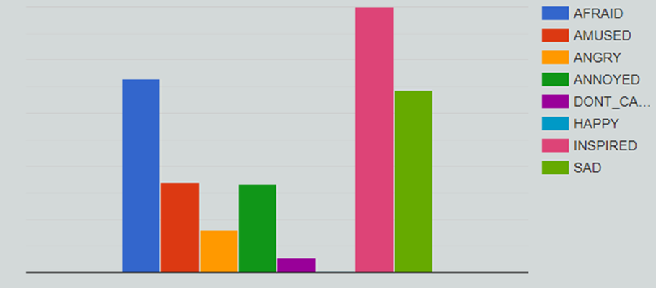
Analiza koju su proveli učenici pomoću Google obrasca
Analiza pomoću DepecheMood-a

Slide 22
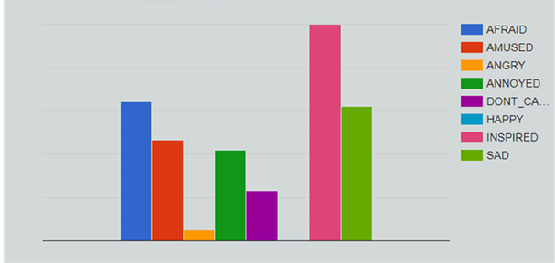
Manipuliranje tekstom- percepcija i dojam čitatelja
"In July, Mark, who works for a small technology company in East London, emailed his manager to tell her that he had tested positive for Covid-19. His boss didn’t ask any questions; instead, she expressed sympathy, wished him a quick recovery and told him to take as much time off as he wanted.
Mark, whose surname is being hidden for job-security reasons, didn’t actually have Covid-19. In truth, he was tired and nervous; the toll of the pandemic, combined with working 80 hours a week, and being expected to be on call all the time, had become too much to handle. The 40-year-old was feeling severely depressed, and suspected that he might be on the edge of a serious clinical burnout."

Slide 23
Ograničenja ovih alata
Alati analiziraju samo tekstove na engleskom jeziku
Za hrvatski jezik je primjenjiv ako nam je bitna samo relativna složenost teksta
Oscilacije: „Pearson” i ”Road to grammar”
imaju različit CEFR
DepecheMood: emocija "inspired" dominira

Slide 24
Pitanja

Slide 25
dajanajelavic@gmail.com mirtakk@gmail.com
https://bit.ly/3i6iC0g

Slide 26
Alati & izvori
Readability Analyzer
http://www.roadtogrammar.text
https://www.english.com/gse/teacher-toolkit/user/textanalyzer/requestdetails
DepecheMood
Menti
Typeform
Answergarden
QR kod
Pixabay
What happens to your brain when you give up sugar
Why the worst parts of work can't easily change

