Slide 1
Kibernetička sigurnost
Intro
Vedran Hafner
Leader, Systems Engeneering
2021
Notes:
Within your organization:
Is the use of SaaS apps prolific?
Are your remote and branch offices moving to direct internet access (DIA) instead of backhauling to a data center first?
Are you considering using SD-WAN to enable your DIA transformation?
Keeping it all secure with limited staff leaves you looking for an easier way.
A secure internet gateway, like Cisco Umbrella, can help.
During this presentation, we’ll discuss:
How Cisco Umbrella integrates multiple security services — DNS-layer security, firewall, secure web gateway, cloud access security broker, and more — to centrally manage protection for all of your remote and branch locations
Umbrella now offers more effective protection from a single platform, reducing the time, money, and resources previously required for deployment, configuration, and integration tasks

Slide 2
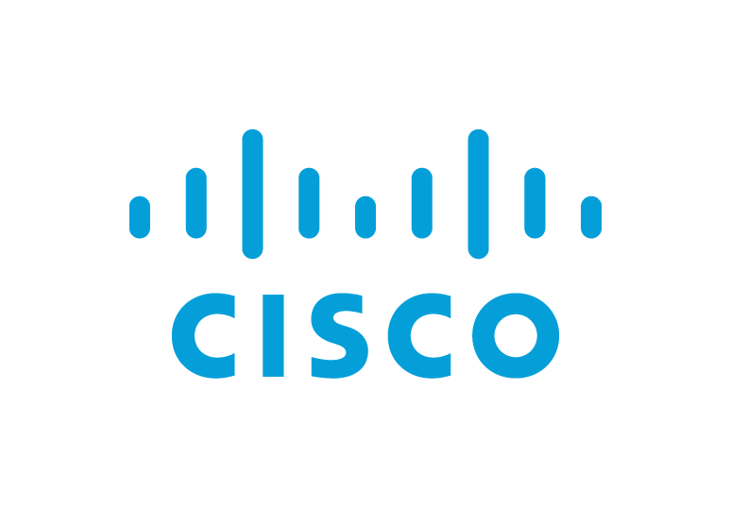
DDoS
Advanced Persistent Threats
Ransomware
Malvertising
Drive by Downloads
Data Destruction
Data Manipulation
Spyware/Malware
Data/IP Theft
Phishing
Monetary Theft
Unpatched Software
Wiper Attacks
Rogue Software
Man in the Middle
Botnets
Trojans

Slide 3
Relentless
Tireless
vs
ATTACKERS
DEFENDERS

Slide 4
Back Then…
Internet
Critical infrastructure
Business apps
Workplace desktops
…it was all about Perimeter Security…
…and a Big Fat Firewall!

Slide 5
But Now: The way we
work has changed
Internet
Critical infrastructure Amazon, Rackspace, Windows Azure, etc.
Business apps
Salesforce, Office 365, G Suite, etc.
Critical infrastructure
Business apps
Workplace desktops
Roaming laptops &
IoT Devices
Branch office

Slide 6
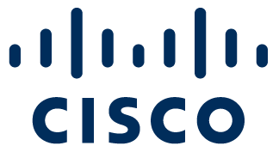
Malicious Binaries and Encryption
Attackers embrace encryption to conceal their command-and-control activity
October 2017
12% Increase
November 2016
50%
38%
268%
19%
70%
Increase
Global Encrypted Web Traffic
Malicious Sandbox Binaries with Encryption

Slide 7
CyberSecurity Challenges
Threat
Visibility
Intelligence driven
Incident Response
Rapid
Containment

Slide 8
95% of All Successful Cyber Attacks are Caused by Phishing
Business Email Compromise “BEC”
Breach-focused Attacks
Customer Phishing
From: Bertolini, Mark (Chairman & CEO)
To: Guertin, Shawn
Subject: Outgoing payment
From: cyndikane@company-a.net
To: jmcnamara@company-b.com
Subject: Fwd: Proforma Invoice
From: Amazon Web Services <noreply-aws@amazon.com>
To: srobson@informatica.com
Subject: Confirm your AWS Account
$100M lost by Google and Facebook in partner invoicing scam
96% of breaches
communicated via email
$9.1B in global losses
Sources: RSA Global Fraud and Cybercrime Forecast 2017, Verizon Data Breach Digest 2018.
Notes:
$9.1 B number comes from Trend Micro: https://www.trendmicro.com/vinfo/us/security/research-and-analysis/predictions/2018

Slide 9
Attackers Use Multiple Ways to Get In
Malware
Business Email Compromise (BEC)
Phishing
Domain Compromise
Ransomware detections up 90% in 2020¹
$5.3 Billion in losses²
$19.1 Billion in 2020³
54% of legitimate domains used in phishing campaigns⁴
Notes:
Ovo su samo 4 trenutno aktualna i navedena nacina kojima se moze mail. Opisi ih…
Iz razloga sto:
Mail sustav kad se radio nije se mislilo na security koliko na konektiviti i uspjesnu razmjenu mailova
Zbog velikog broja nacina na koji se moze uci u mrezu
Sto krajnji korisnici koji su rak rana svakog security sustava svakodnevno koriste ovaj sustav kao primaran oblik komunikacij
bitno je imat multilayer security prlatformu koja ce mail skeniratu putem vise engina i u slucaju da jedan odredjeni engine kleknei neuspije detektirati
As you can see on the slide, attackers use a variety of ways.
Here are the main four problem areas when it comes to threats in incoming email: malware, business email compromise and phishing, which have resulted in billions worth of losses to organizations globally each year.
Malware hidden in attachments and specifically ransomware has been a big problem the last few of years. As you might be aware, in a ransomware attack, bad actors use malware to encrypt critical files within your network, essentially changing the locks on your own system and crippling operations. And it’s not just the cost of paying the ransom to the criminals, it’s also about the cost of recovering from the attack. The city of Atlanta’s $50K Ransomware attack that shut down the city for nearly a week has been estimated at a price tag of $2.7M to fix.
https://www.wsbtv.com/news/local/atlanta/ransomware-attack-cost-city-27-million-records-show/730813530
Ransomware detections went up 90% in 2017 from the previous year as you see on the slide.
The second technique attackers use is Business Email Compromise or BEC. In a BEC attack cyber criminals extensively research a target to masquerade as a legitimate party. Attackers forge a message to appear as if it is coming from a friendly email address owned by a trusted employee or executive within the business. The goal is to fool the recipient into disclosing sensitive information or access to finances. The FBI estimates BEC has cost companies $5.3B over 3 years. The FBI also reports that there are 40 thousand reported BEC instances annually with an average loss per BEC incident of $129,427
The next technique is an old one – phishing. Businesses are constantly bombarded with phishing messages attempting to lure employees into clicking malicious URLs so they can enter their credentials, which attackers can then utilize. The annual cost of phishing to global organizations was $9.1 billion in 2017 alone as you see on the slide.
The last challenge customers are facing is what we call domain compromise and this relates to outgoing email. Essentially, attackers use legitimate company domains to carry out phishing campaigns. In the Cisco Annual Cybersecurity Report researchers found that 54% of legitimate domains were being used in phishing in a study conducted. This hurts your brand because bad actors send out emails to your own customers and partners fraudulent emails using your domain. You need visibility into who is using your domain and we will talk about that in a few slides when I cover the securing outbound emails section.
Transition: The question is: how do you best protect your users against these attacks? Let’s focus on that starting with the next slide.

Slide 11
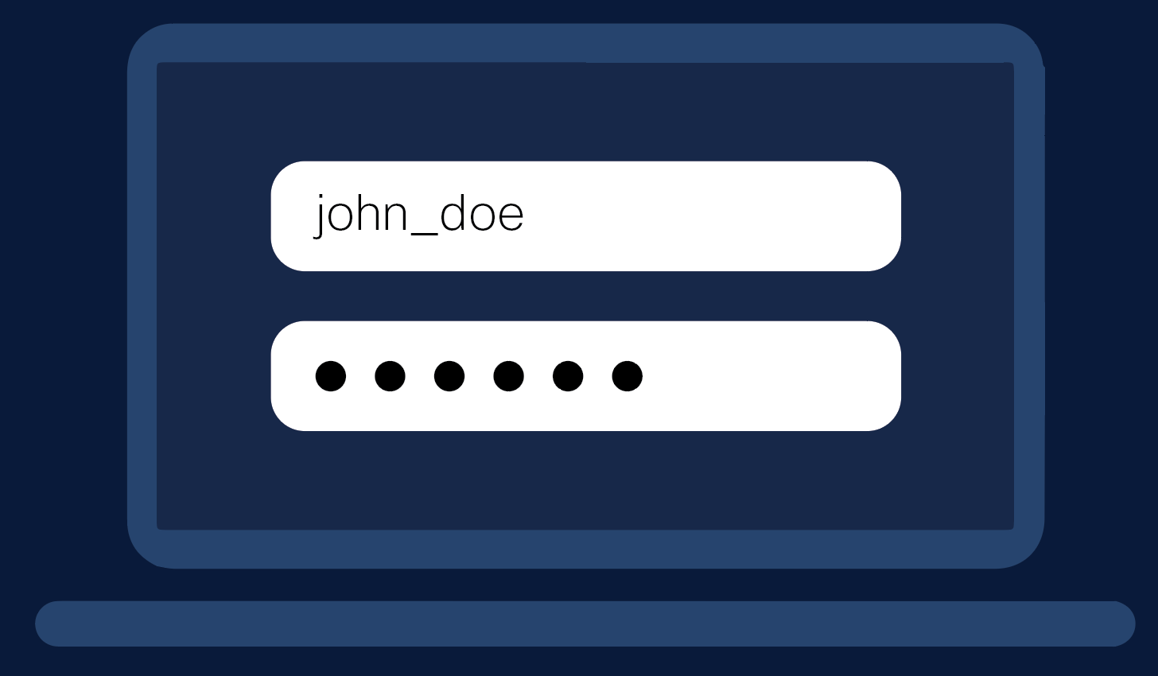
Stealing credentials
Credentials help attackers navigate laterally under the radar.
Stealing and using legitimate credentials to gain access is more likely to go undetected.
Using stolen credentials second-most common activity conducted by attackers during a breach.¹
Notes:
¹ Verizon 2019 Data Breach Investigations Report

Slide 12
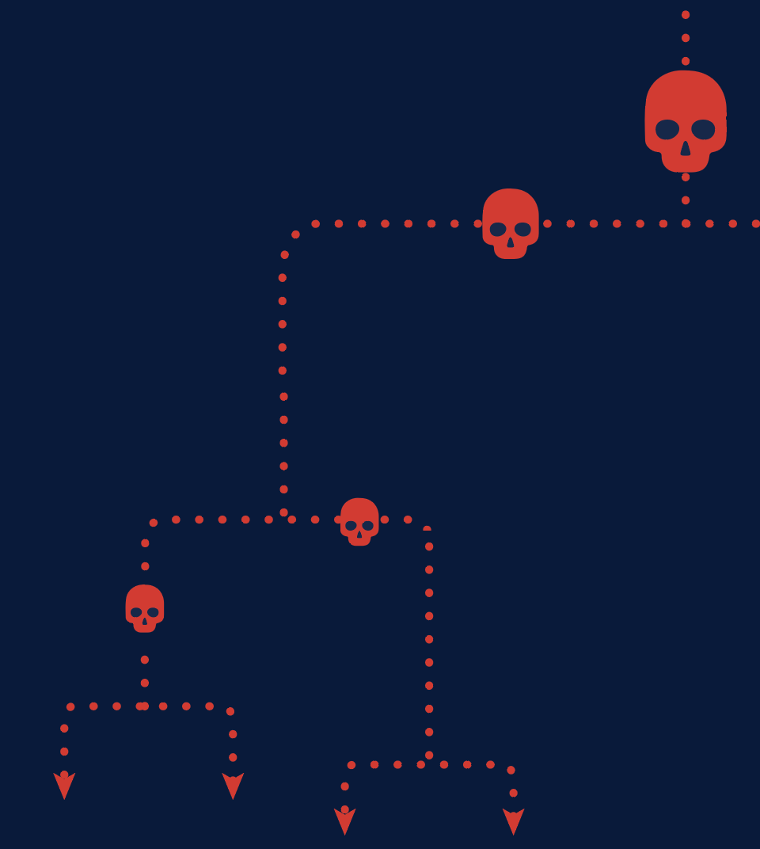
Credential caching
There are a variety of places in OSes where credentials are stored for everyday operation.
OSes reduce the number of times a user enters their password.
If an attacker can gain access to a system, they can attempt to locate, copy, and “dump” the credentials.

Slide 13
Tools of the trade
There are several tools an attacker can wield to steal credentials.
Most popular credential dumping tool is Mimikatz.
Mimikatz is an important tool for pen testers.
Unfortunately also popular with malicious actors.
.#####. mimikatz 2.0 alpha (x86) release "Kiwi en C" (Apr 6 2014 22:02:03)
.## ^ ##.
## / \ ## /* * *
## \ / ## Benjamin DELPY `gentilkiwi` ( benjamin@gentilkiwi.com )
'## v ##’ http://blog.gentilkiwi.com/mimikatz (oe.eo)
'#####’ with 13 modules * * */

Slide 14
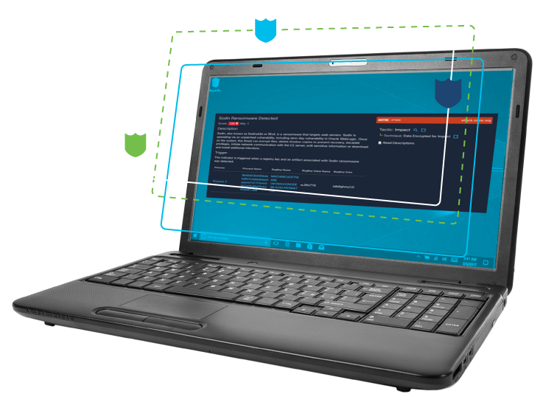
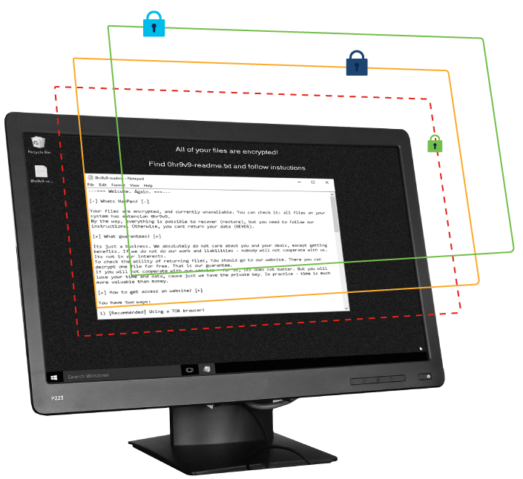
The REvil ransomware
Threat Protection
Notes:
See the following blog for further details of the content in these slides:
https://blogs.cisco.com/security/threat-protection-the-revil-ransomware

Slide 15
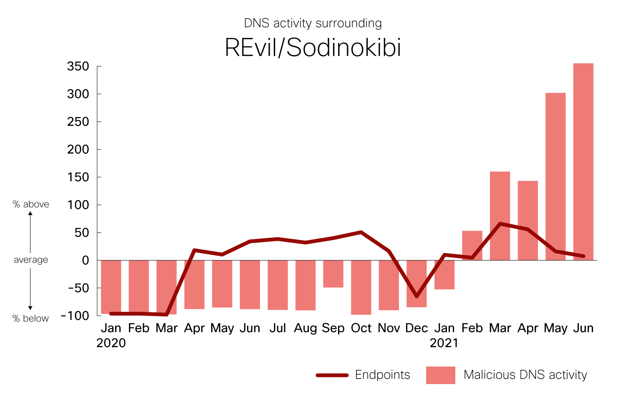
The REvil ransomware
Ransomware family involved in high-profile attacks.
Part of a ransomware-as-a-service model.
Revisited metric on DNS activity
Number of endpoints similar in 2021
Dramatic rise in DNS activity
Notes:
REvil has been in the news due to it’s use in several high-profile attacks: JBS, Kaseya, etc.
REvil uses RaaS model: affiliates work alongside the REvil developers to compromise networks. These affiliates then split the ransom with the threat actors who develop REvil.
We took a look at DNS activity for REvil in 2020, and recently revisited it for the first half of 2021
According to this data, the average number of endpoints impacted by REvil in a given month was similar in 2020 and 2021
However, there was a dramatic increase in DNS activity in 2021, when these high-profile attacks occurred.

Slide 16
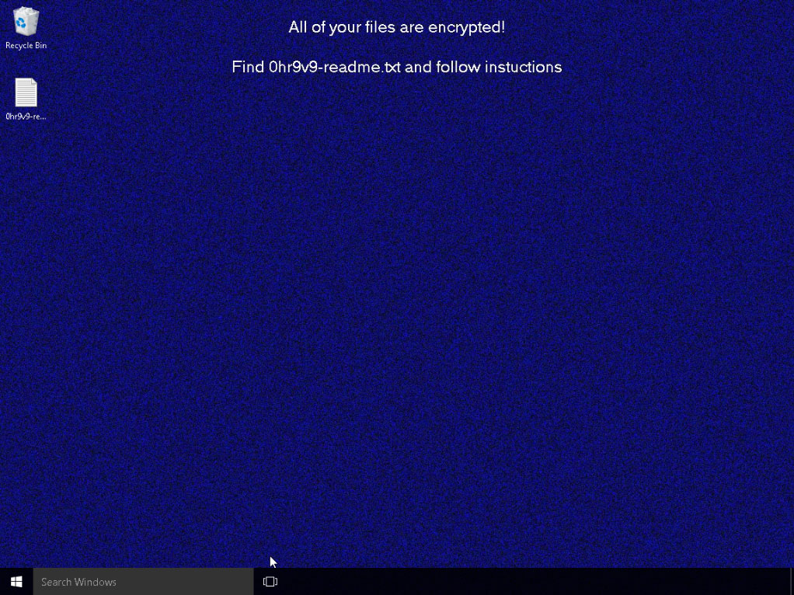
The REvil ransomware
How does REvil take control of a system?
Functionality varies though end result largely the same.
We used Cisco Secure Malware Analytics to look at samples.
Notes:
We going to talk about how REvil works, or what it does to a computer in the process of locking it down.
The behavior and functionality present in REvil from one campaign to the next does vary.
For example, in the case where REvil leveraged Kaseya software, there was no C2 functionality, since the threat actors used the Kaseya software to send instructions instead.
Still, there are several core behaviors worth examining, and the result is largely the same from one campaign to the next.
To look at these behaviors in detail, we used Cisco Secure Malware Analytics.
Malware Analytics provides advanced threat sandboxing, giving context-rich malware analytics and threat intelligence, allowing security teams to quickly respond to threats.
We looked at several REvil samples in Malware Analytics what follows is the findings.

Slide 17
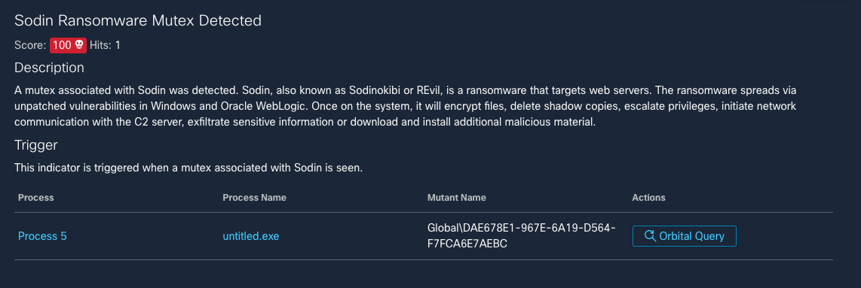
Creates a mutex
Notes:
In almost all cases, REvil creates a mutex.
In software development, a mutex is used to ensure that only one copy of a given program runs at a time.
Let's say for example, you launch Outlook on your PC. Then you try to launch it again.
The software will check to see if the mutex is running, and if it is, it won't launch a second copy.
Malware often does this too.
The silver lining here is that a mutex can also be used to identify the malware and block it.

Slide 18
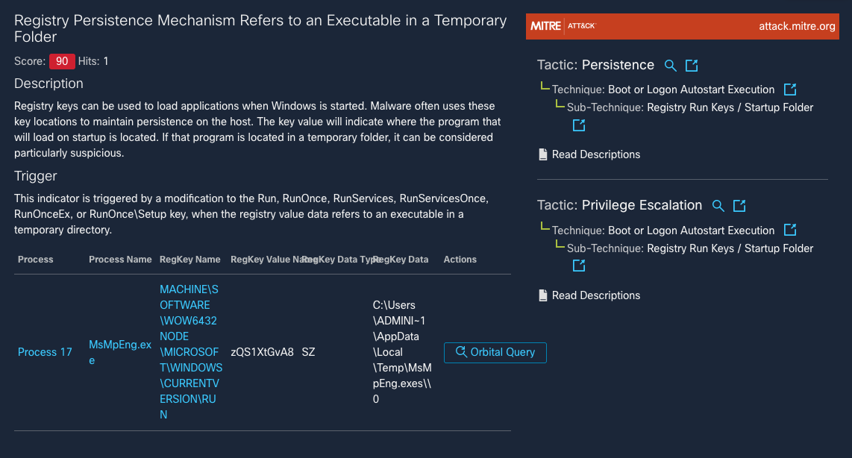
Establishes persistence
Notes:
After creating the mutex, REvil will often work to establish persistence.
It usually does this by creating registry keys so that the threat will start when Windows starts, allowing it to survive a reboot of the computer.
The creation of run keys, like mutexes, is a fairly common practice for software.
However, REvil sometimes creates run keys that point to files in temporary folders.
This sort of behavior is hardly ever done by legitimate programs since files in temporary folders are meant to be just that—temporary.

Slide 19
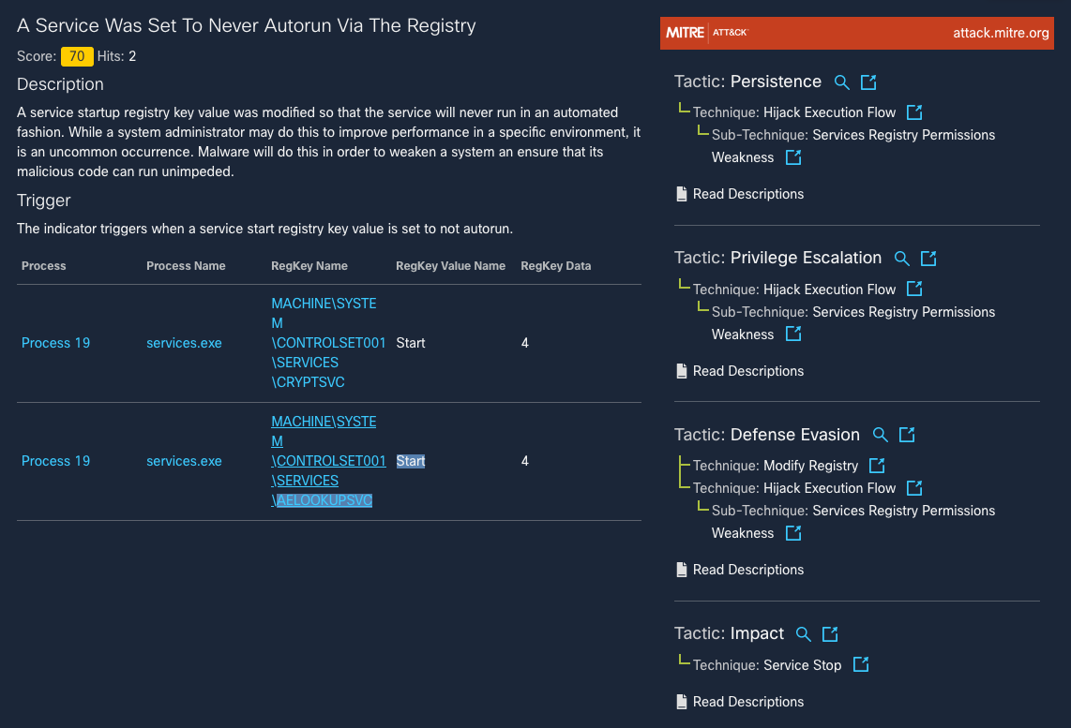
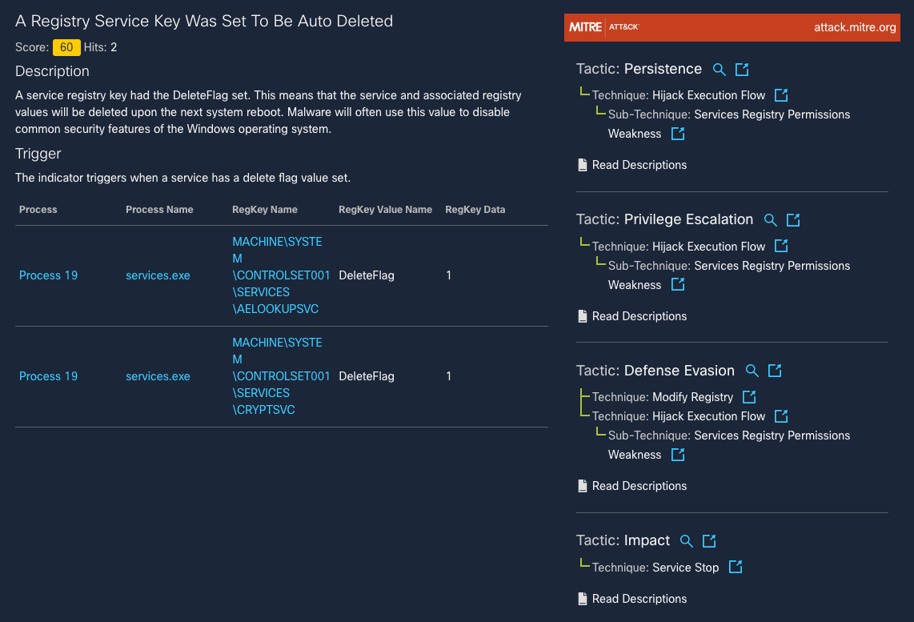
Stopping processes and services
Notes:
In addition to creating registry keys, REvil also terminates processes and services that may interfere with its operations.
On the left side, REvil is changing registry keys for two services that start when Windows start.
One of services are involved in managing file signatures and certificates, and the other looks after application compatibility.
Disabling these makes it easier for REvil to execute further code on the compromised computer.
In another instance (right side) REvil attempts to delete these registry keys and services, instead of simply disabling them.
It’s a more severe approach, but the advantage is that it prevents the services from simply being re-enabled.

Slide 20
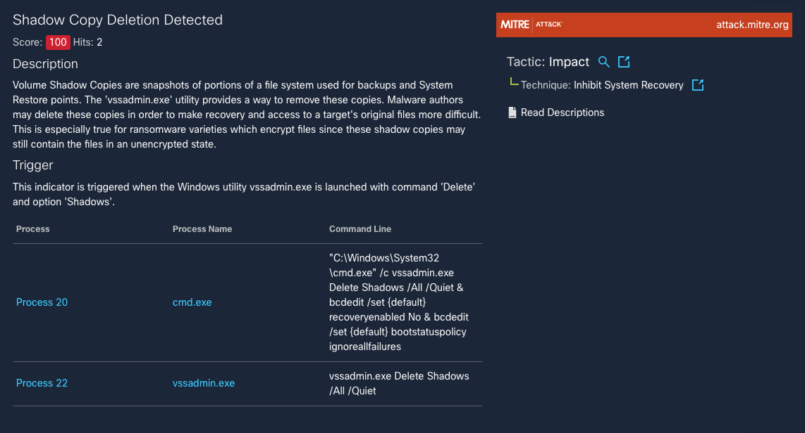
Deleting backups
Notes:
REvil looks for and deletes backups on the machine.
In particular, these backups are called “shadow copies”
If these shadow copies were left on the machine, it could still be possible for a user to restore the files that have been encrypted.
So REvil deletes these shadow copies.
This essentially takes local file restoration off the table.

Slide 21
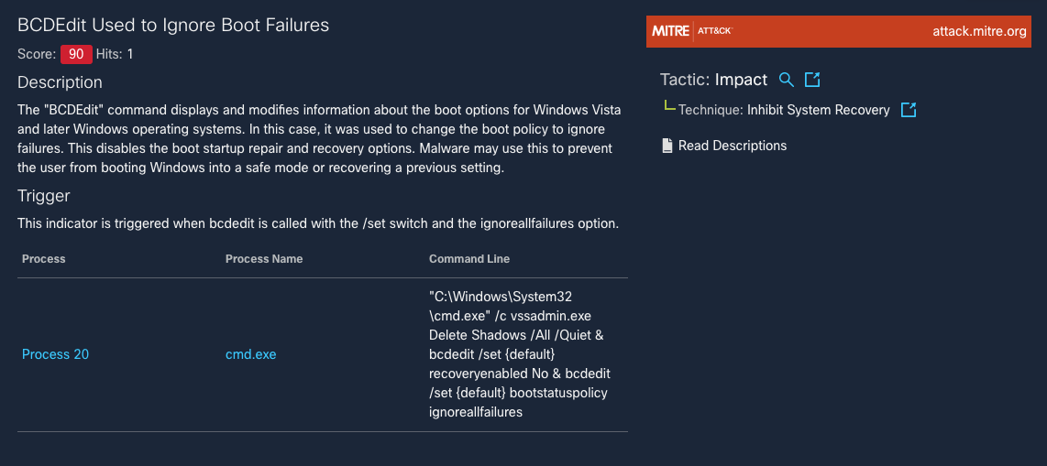
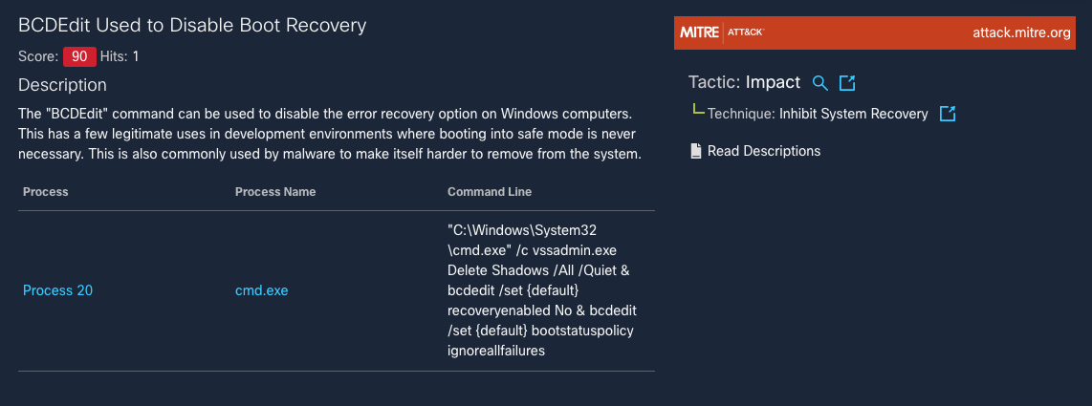
Disabling Windows recovery tools
Notes:
REvil also often disables various Windows recovery tools that are generally accessible when rebooting a computer, as seen on the left.
Disabling these tools makes it even harder to restore a computer.
Revil also tells Windows to ignore boot failures, as shown on the right side.
While hiding a boot failure in and of itself isn’t critical, what this does given the way Windows is set up, is it hides the Windows recovery tool menu.
This is another way that prevents access to recovery tools.

Slide 22
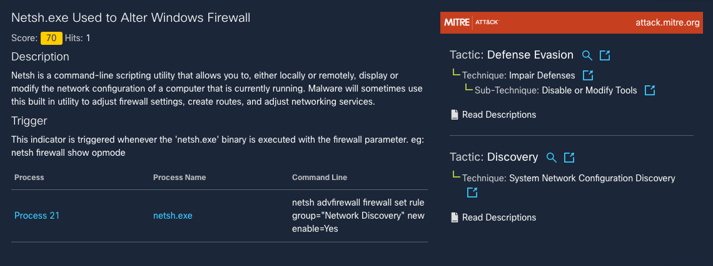
Changing firewall rules
Notes:
In terms of the network, REvil often makes changes to the Windows Firewall.
There are a number of things it could do, but we often saw it enabling Network Discovery.
This makes it easier for REvil to find other computers on the network and spread further.

Slide 23
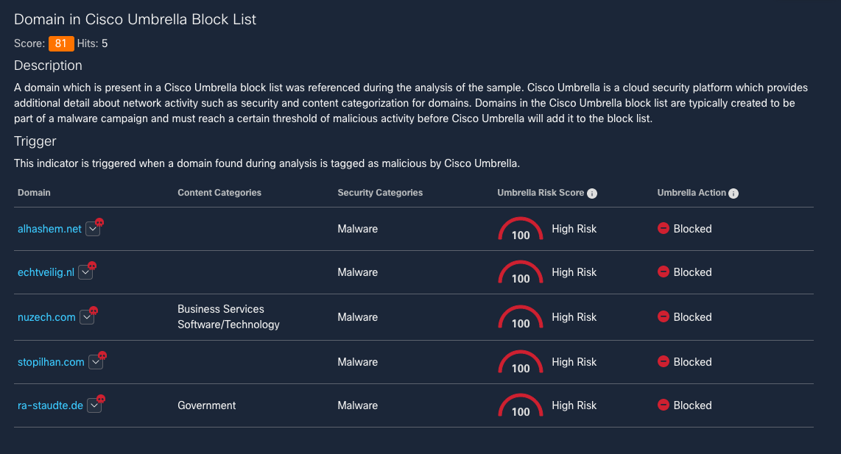
Contacting the C2 server
Notes:
To carry out various functions remotely, the threat actors behind REvil often need it to connect back to a C2 server.
There are exceptions, such as the Kaseya-based attacks mentioned earlier, where the Kaseya software was leveraged for communication.
In this particular example, each of the C2 servers listed here have been classified as high risk by Cisco Umbrella.
With Umbrella Investigate on the right, we’re able to see that the domain is specifically associated with REvil.
In this case connections were blocked by default.

Slide 24
Encrypting files
Notes:
Now everything up to this point is preparation for REvil’s core task.
That’s encrypting the files on the drive.
This is generally where you see the computer slowing down and might even hear the hard drive grinding away.
This step can take a while, depending on the size of the hard drive.

Slide 25
Creating ransom notes
Notes:
As REvil encrypts the drive, it also creates and drops ransom notes throughout the drive.
These files contain info about how to pay the ransom.
We’ll look at one of these in a moment.

Slide 26
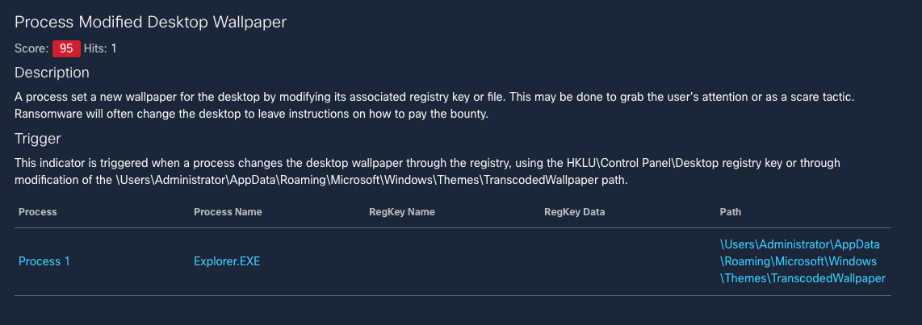
Changing desktop wallpaper
Notes:
Finally, as the encryption wraps up, REvil will change the desktop wallpaper, giving a clear visual indication that the computer has been compromised.
The new wallpaper includes a message guiding the user to the ransom file, containing the instructions to recover the files.

Slide 27
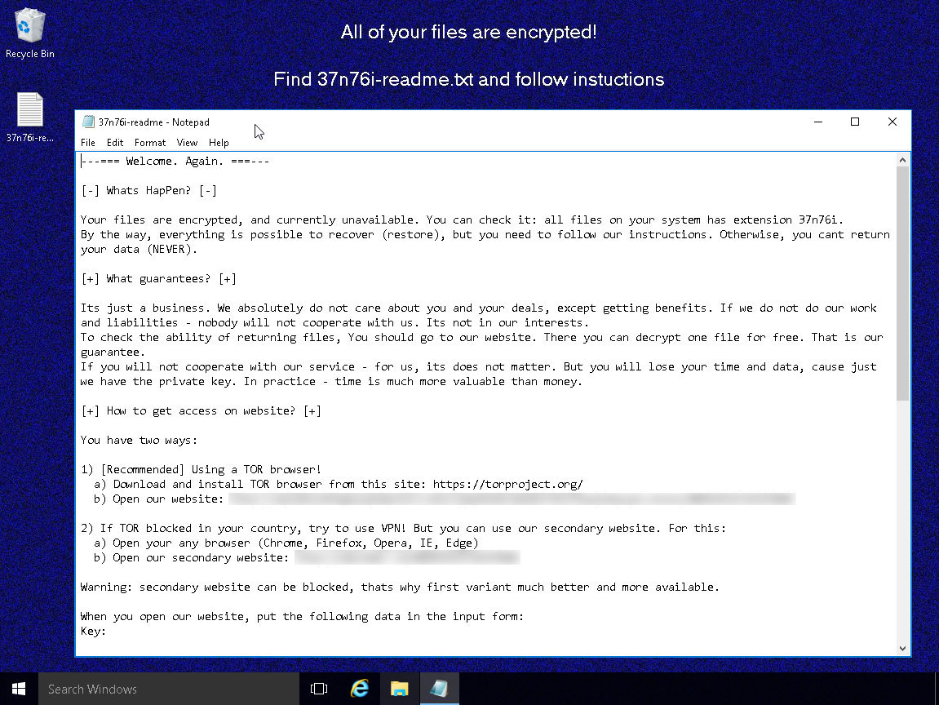
Notes:
And here is what an encrypted desktop looks like, with the ransom note open.
There are a few interesting things in the ransom note.
For instance, the attackers make the claim that “this is just business”
They give a couple of options for restoring files.
They also mention the random file extension that REvil has used.

Slide 28
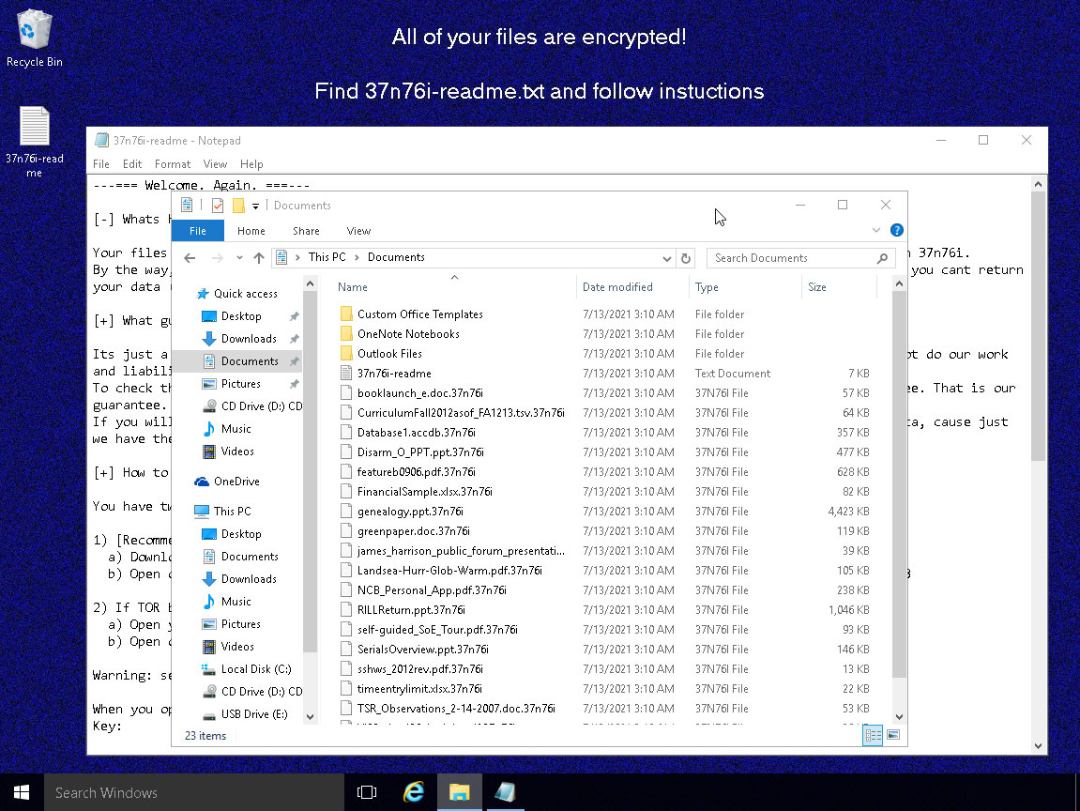
Notes:
You can see here the files in the documents folder have all been encrypted with this file extension.
This computer is now effectively unusable.

Slide 29
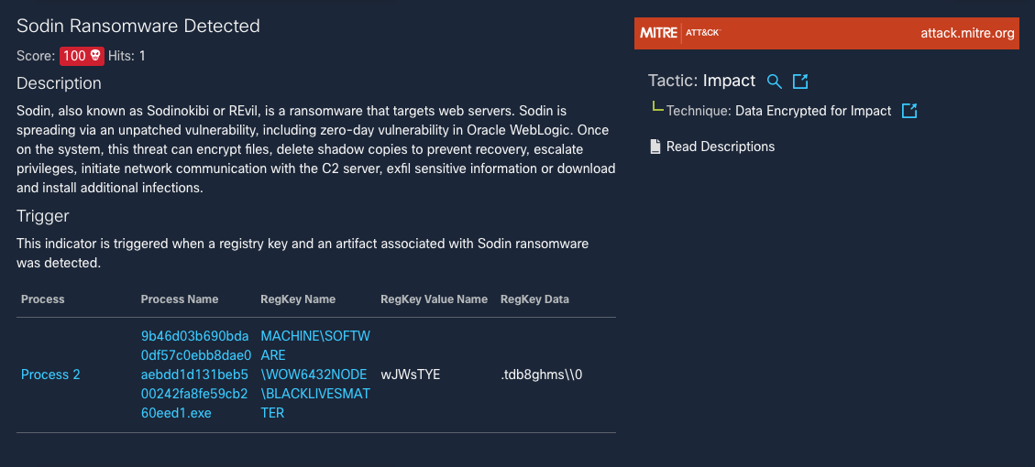
Defense in the real world
Notes:
So in terms of real world defense, if you have endpoint protection in place, it’s unlikely you’ll see all this play out.
For instance, with Cisco Endpoint Protection, REvil will likely be caught before it could even execute (left side).
In this case, the threat has been blocked by Secure Endpoint’s “Sodin” detection.
However, REvil’s behavior is sometimes so standard that it can get picked up by a generic ransomware signature (right side).
The fact is that REvil doesn’t act that different from one campaign to the next
With security protections in place, it can generally be caught before it can wreck havoc on a system or network.

Slide 30
Cisco Umbrella
Accelerate Secure Cloud Adoption
2021
Notes:
Within your organization:
Is the use of SaaS apps prolific?
Are your remote and branch offices moving to direct internet access (DIA) instead of backhauling to a data center first?
Are you considering using SD-WAN to enable your DIA transformation?
Keeping it all secure with limited staff leaves you looking for an easier way.
A secure internet gateway, like Cisco Umbrella, can help.
During this presentation, we’ll discuss:
How Cisco Umbrella integrates multiple security services — DNS-layer security, firewall, secure web gateway, cloud access security broker, and more — to centrally manage protection for all of your remote and branch locations
Umbrella now offers more effective protection from a single platform, reducing the time, money, and resources previously required for deployment, configuration, and integration tasks

Slide 31
Networking and security teams struggle to…
…connect users anywhere to applications everywhere
…protect against evolving threat vectors
…deliver high quality user experience
A new approach is needed…
Notes:
As a result of these changes, networking and security teams struggle to…
1) Connect users to applications and data
Poor user experience when accessing cloud apps
Complexity in connecting to multiple cloud providers
2) protect against evolving threat vectors
Gaps in security protection
Inconsistent policies enforced across disparate locations
Difficult to verify identity of users and devices
Too much complexity in managing multiple siloed solutions, different panes of glass, different sets of policies which leads to errors, overlapping teams/functionality, potential holes in security
3) Deliver high quality user experience
Lack end-to-end granular visibility
Challenging to isolate and resolve performance issues across internet, cloud, and SaaS
Unable to get escalations and enforce SLAs
This requires a new approach to networking, security, and monitoring…

Slide 32
Today’s cloud-centric world
Drives the need for a secure access service edge (SASE) architecture
Combine networking and security functions in the cloud
Connect users to the apps and data needed — in any environment, from anywhere
Control access and enforce the right security protection consistently
Internet/SaaS/IaaS
Secure Access Service Edge
All locations
Headquarters/ campus
Remote workers
Notes:
Today’s cloud-centric world drives the need for a secure access service edge(SASE; pronounced “sassy”) architecture
What is SASE?
Secure access service edge (SASE) combines networking and security functions in the cloud to deliver secure access to applications, anywhere users work. The core functions include software-defined wide area network (SD-WAN), firewall as a service, secure web gateway (SWG)s, cloud access security broker (CASB), and zero trust network access (ZTNA). The goal of the SASE model is to consolidate these functions—which were traditionally delivered in siloed point solutions—in a single, integrated cloud service.
SASE helps organizations:
Combine networking and security functions to deliver secure connectivity as a service
Connect users seamlessly to the applications and data they need to access — in any environment, from any location
Control access and enforce the right security protection anywhere users work

Slide 33
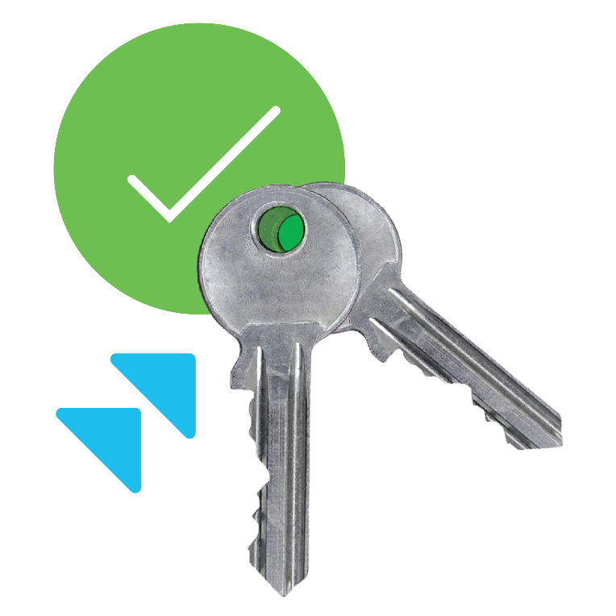
Cisco Secure Access by Duo
Zero Trust for the Workforce
Duo Security is now part of Cisco Secure.

Slide 34
What’s Different in a Zero-Trust Approach
The Traditional Approach
The Zero Trust Approach
Trust is based on the network location that an access request is coming from
Trust is established for every access request, regardless of where the request is coming from
Once attackers are in they can move laterally within a network to get to the crown jewels
Doesn’t extend security to the new perimeter of cloud, mobile and hybrid environment
Secures access across your applications and network. Ensures only right users & devices have access
Extends trust to support a modern enterprise with BYOD, cloud apps, hybrid environments & more
Notes:
When you compare traditional security approaches to a zero-trust approach, you will find that:​
​
- In the old approach, trust is based solely on the network location the access request originates from​
- In a zero-trust approach, trust is more dynamic and adaptive. It's established for every access request, no matter where it comes from.​
​
This approach prevents attackers from moving laterally within your network to get to your data – it secures access across your apps and networks, and only allows the right users and devices to get access.​
​
In addition to a better access security, a zero-trust approach also supports modern enterprise models with BYOD, cloud apps, hybrid cloud/on-premises environments and more.​

Slide 35
Outcomes, Use Cases and Lead Products
Cisco Zero Trust for Workforce
Key Use Case: Secure Remote Work
Lead Product: Cisco Secure Access by Duo
Outcome: Protect the workforce, Cisco ensures only the right users and secure devices can access applications.
Cisco Zero Trust for Workloads
Key Use Case: Secure Across Multi-Cloud Lead Product: Cisco Secure Workload Outcome: Protect the workloads, Cisco secures all connections within apps, across multi-cloud.
Cisco Zero Trust for Workplace
Key Use Case: Network Visibility and Segmentation Lead Product: SD-Access for Workplace
Outcome: Protect the workplace, Cisco secures all user and device connections across your network, including IoT.
Notes:
Security is not a one-size-fits-all proposition, even within the same enterprise environment. When approaching security design using the zero trust model it is easier to break adoption down into these three pillars: the workforce, workload, and workplace
A zero-trust approach doesn’t require a complete reinvention of the infrastructure. The most successful solutions should seamlessly integrate without entirely replacing existing investments
To protect the workforce, Cisco ensures only the right users and secure devices can access applications. Protect against phishing, compromised credentials or other identity-based attacks.
To protect workloads, Cisco secures hybrid, multi-cloud workloads and contains lateral movement of attacks through micro-segmentation. Continuously monitors and detects software vulnerabilities and blocks communication to reduce the overall attack surface.
To protect the workplace, Cisco provides insight into users and devices, identify threats and maintain control over all connections over your network, including Internet of Things (IoT) devices
This complete zero-trust security model allows you to mitigate, detect and respond to risks across your environment.

Slide 36
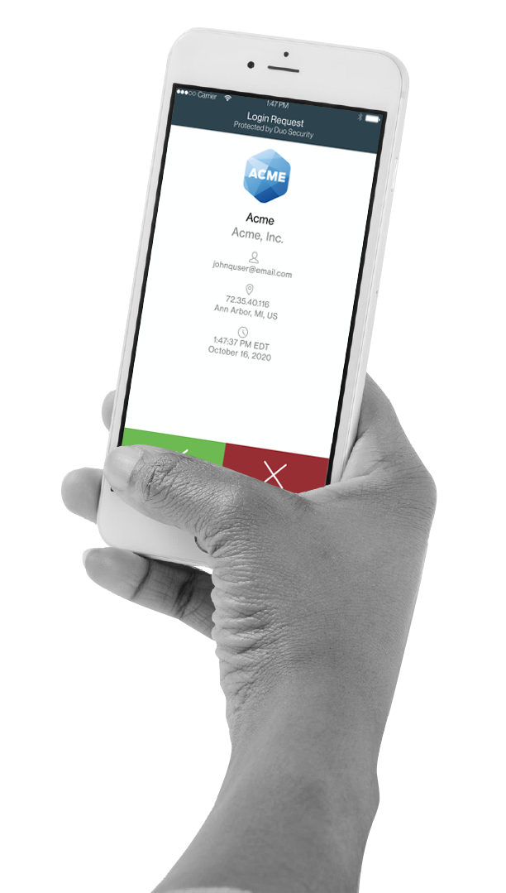
World’s Easiest and Most Secure MFA
Instantly integrates with all apps
Users self-enroll in minutes
Users authenticate in seconds; no codes to enter

Slide 37
Broadest Range of Multi-Factor Authentication (MFA) Options
Wearables
Push
Phone Call
######
Soft Token
Configure authentication options for each application or group of users
Enable multiple option for users for ease of use and flexibility
Biometrics
U2F
Hardware
Tokens
SMS

Slide 38
Meet Compliance Requirements
Every security best practices guide and regulation asks for MFA and device visibility
Meet MFA requirements outlined in PCI-DSS 3.2 Section 8.3
Helps meet NIST 800-63 and 800-171 access security requirements
Meet DEA’s EPCS requirements when approving e-prescriptions
Aligned with GDPR data protection laws in Europe
Meet FFIEC requirements for financial applications
Get visibility into personal devices used to access PHI
Notes:
Objective: Validate if the prospect has a compliance driver? If so, which one?
Key talking points:
MFA or user authentication is a requirement or best practice in every major compliance requirement or security framework
Ask your customer:
What compliance requirements do you have to comply with?
Are there MFA requirements in your compliance framework?
Have you conducted a security audit or pentest recently? What were the findings on user access controls

Slide 39
Duo Supports Your Work Applications
Start Here
Then Expand
VPN RA
Multicloud
Email/MSFT
On-Prem
SSO
Custom
REST
APIS
WEB SDK
RADIUS
SAML
RRAS
OIDC
Learn more about application integrations
Notes:
Objective: Summarize how Duo can protect all applications + confirm priority for applications they want integrated with Duo
Key talking points:
Duo is incredibly easy to deploy across all types of applications (cloud/on-premises)
Start with out-of-the-box integration with VPNs, Email, and cloud applications.
Then, continue with other Microsoft apps, RDP, SSH, and on-prem apps.
Integration guides, step-by-step instructions and videos are available to customers at duo.com/docs page
Duo doesn’t license per application
Customer story: Ohio State University (CISO): Went live with Duo in front of their HR Self Service portal. In less than a month 32,000 employees enrolled with Duo. The CISO said Duo has been one of the most successful project in IT (not just Security) at Ohio State. Both the President and Provost have personally commented on how easy it is to use Duo

